Slide 1
UNIT 1 – INTRODUCTION TO C PROGRAMMING

Slide 2
C is a general-purpose programming language developed by Dennis Ritchie at Bell Labs in 1972. It is one of the most widely used programming languages and forms the foundation of many modern programming languages.
Supports procedural and structured programming.
Fast execution speed and low-level memory access capabilities.
Widely used in operating systems, embedded systems, compilers, and system software development.

Slide 3
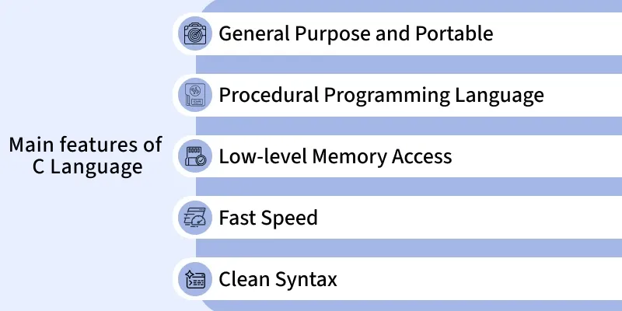

Slide 4
UNIT 1 – INTRODUCTION TO C PROGRAMMING
1. Introduction to Computing
Computing is the process of using computers to solve problems and process data.
Basic steps:
Input → Processing → Output → Storage
Input: Data given to the computer.
Processing: Computer performs operations on the data.
Output: Result produced by the computer.
Storage: Saving data/results for future use.

Slide 5
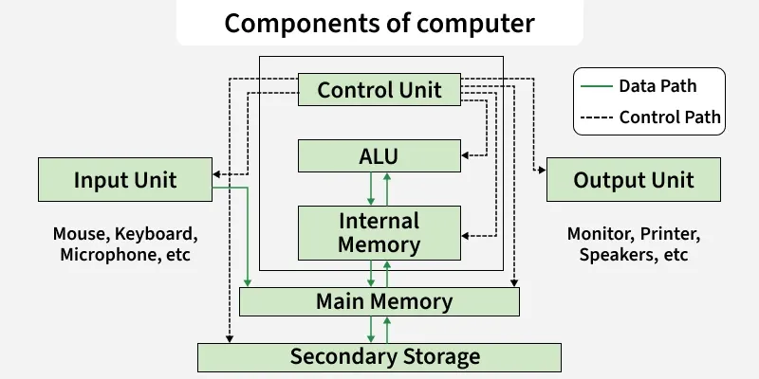

Slide 6
Computer Hardware:
Hardware includes all the physical electronic and mechanical parts of a device. It is divided into several categories:
Internal components: Parts inside the computer case like the Central Processing Unit (CPU), motherboard, and RAM.
Input devices: Tools used to send data to the computer, such as a keyboard and mouse.
Output devices: Tools that display or project results from the computer, such as monitors and printers.
Storage devices: Components that hold data, such as hard disk drives (HDDs) and solid-state drives (SSDs).

Slide 7
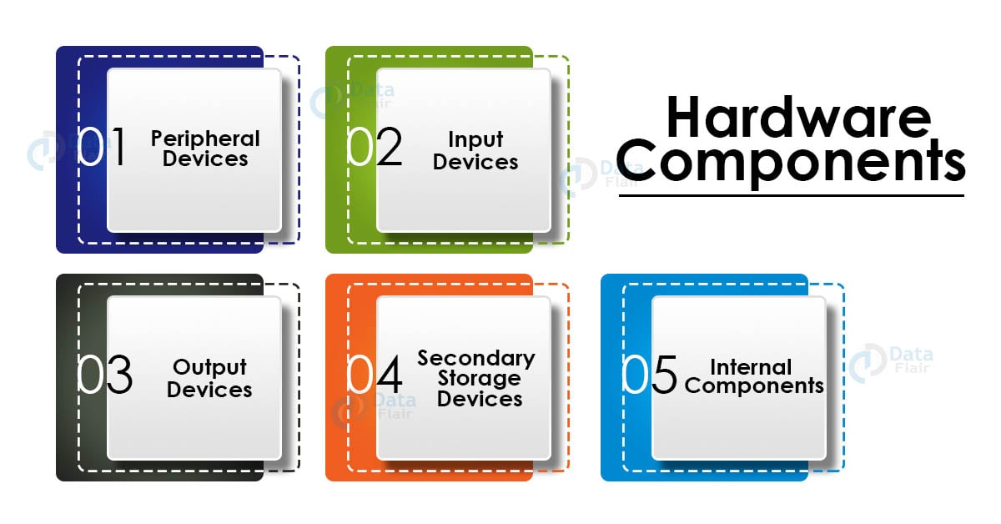

Slide 8
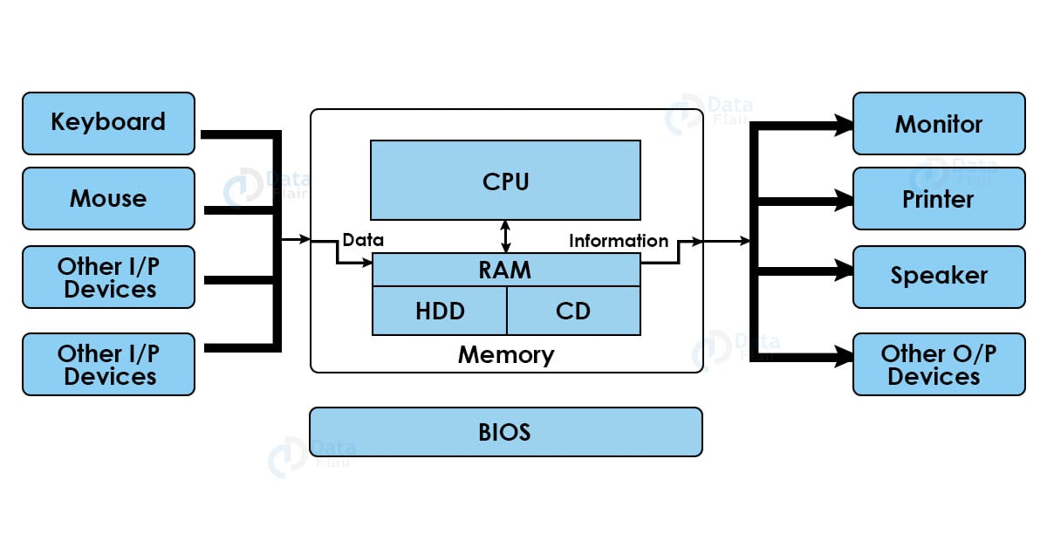
Hardware Architecture

Slide 9
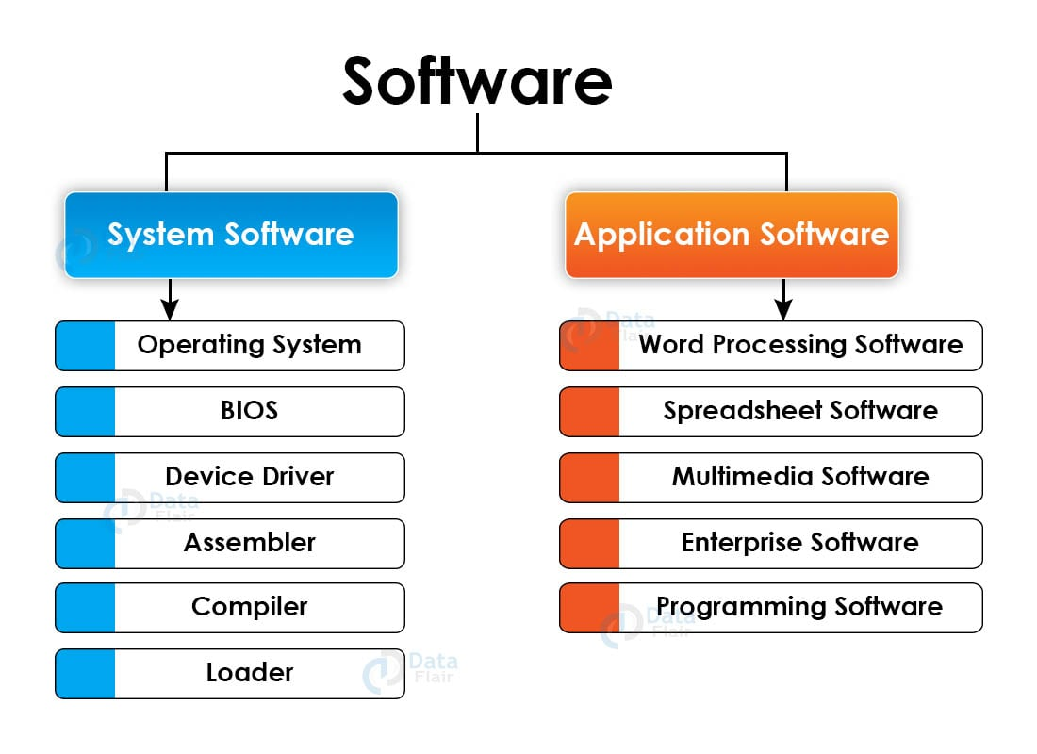
Computer Software

Slide 10
Programming languages are structured tools used to write instructions that a computer can understand and execute.

Slide 11
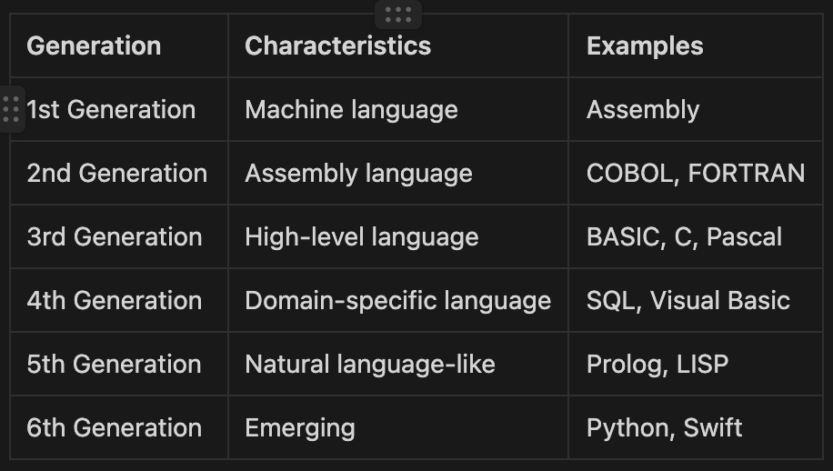

Slide 12
Problem Solving Technique:
Step 1: Identify and Define Problem
Explain you problem clearly as possible as you can.
Step 2: Generate Possible Solutions
List out all the solution that you find. Don’t focus on the quality of the solution
Generate the maximum number of solution as you can without considering the quality of the solution
Step 3: Evaluate Alternatives
After generating the maximum solution, Remove the undesired solutions.
Step 4: Decide a Solution
After filtering all the solution, you have the best solution only. Then choose on of the best solution and make a decision to make it as a perfect solution.
Step 5: Implement a Solution:
After getting the best solution, Implement that solution to solve a problem.
Step 6: Evaluate the result
After implementing a best solution, Evaluate how much you solution solve the problem. If your solution will not solve the problem then you can again start with Step 2.

Slide 13
2. Problem Solving Techniques
Problem solving means finding a systematic way to solve a given problem using a computer.
Main steps:
Understand the problem.
Identify input and output.
Develop an algorithm.
Represent the solution using a flowchart/pseudocode.
Write the C program.
Compile and execute.
Test and debug the program.

Slide 14
Algorithm
An algorithm is a finite sequence of clear and step-by-step instructions used to solve a problem.
Characteristics:
Input: Accepts zero or more inputs.
Output: Produces at least one result.
Definiteness: Every step must be clear.
Finiteness: Must terminate after a finite number of steps.
Effectiveness: Each step should be practical and executable.
Example: Add two numbers
Start
Read A and B
Calculate SUM = A + B
Display SUM
Stop

Slide 15
4. Flowcharts
A flowchart is a graphical representation of an algorithm.
Important symbols:
Symbol | Purpose
Oval | Start / Stop
Rectangle | Process
Parallelogram | Input / Output
Diamond | Decision
Arrow | Flow direction

Slide 16
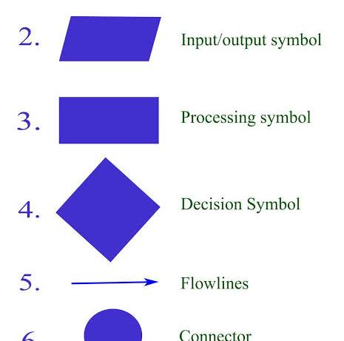

Slide 17
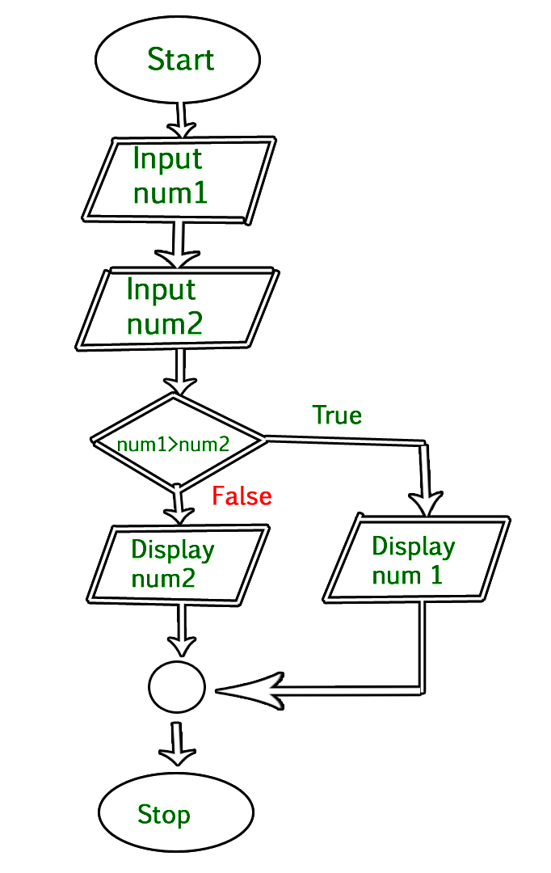

Slide 18
Advantages:
Easy to understand.
Helps in program planning.
Makes errors easier to identify.
Provides a visual representation of the solution.

Slide 19
Pseudocode
Pseudocode is a simple, informal way of writing the steps of an algorithm using English-like statements.
Example:
START
READ A, B
SUM = A + B
PRINT SUM
STOP
It is not an actual programming language and does not follow C syntax

Slide 20
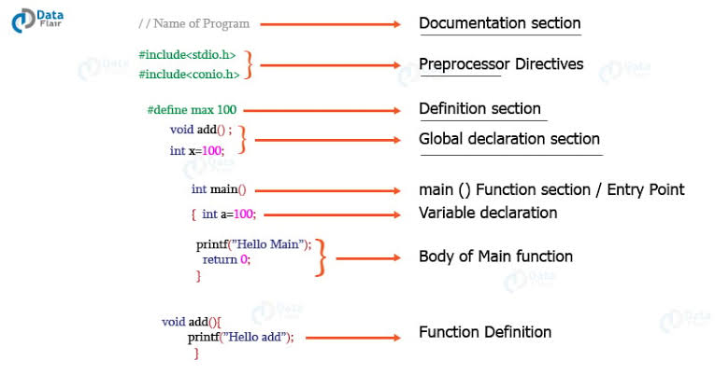
6. Structure of a C Program

Slide 21
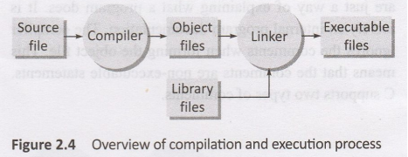
Compiling and Execution process

Slide 22
CHARACTER SET IN C
English alphabet: Include both lower case (a - z) as well as upper case (A - Z) letters
Digits: Include numerical digits from 0 to 9
Special characters: Include symbols such as ~, @, 응, ^,&, *, {, }, <. >, =,_,+,-,$, /, (, ), \, ;,:,[, ],’,”,?,.,!,.
White space characters: These characters are used to print a blank space on the screen
Escape sequence: They include \\, \', \", \n, \a, \0, \?.

Slide 23
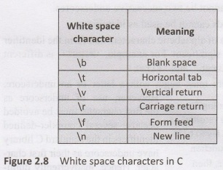

Slide 24
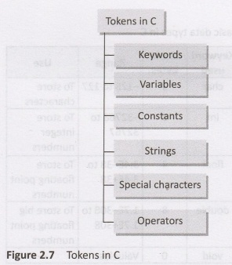
C TOKENS
Tokens are the basic building blocks in C language. You may think of a token as the smallest individual unit in a C program. This means that a program is constructed using a combination of these tokens. There are six main types of tokens in C.

Slide 25
Variables
Variables are containers for storing data values, like numbers and characters.
You can think of a variable as a named box where you keep a value that can be used later.
In C, variables must have a specific type, which tells the program what kind of data the variable can store.
int - stores whole numbers (integers), such as 123 or -123
float - stores numbers with decimals, such as 19.99 or -19.99
char - stores a single character, such as 'a' or 'B'. Characters are surrounded by single quotes

Slide 26
Data Types
Data Type | Size | Description | Example
int | 2 or 4 bytes | Stores whole numbers, without decimals | 1
float | 4 bytes | Stores fractional numbers, containing one or more decimals. Sufficient for storing 6-7 decimal digits | 1.99
double | 8 bytes | Stores fractional numbers, containing one or more decimals. Sufficient for storing 15 decimal digits | 1.99
char | 1 byte | Stores a single character/letter/number, or ASCII values | 'A'

